Slide 1
Team II: Functional Annotation
Group members:
Michael Pham
Akshita Singh
Kaize Ali
Kate Xie
Lindsey Tucker
Isabelle Du Plessis

Slide 2
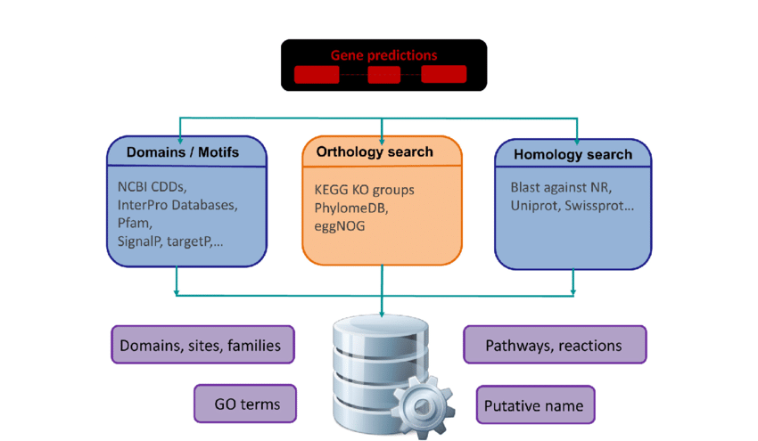
What is functional annotation?
Identifying functional elements along the sequence of a genome, thus giving meaning to it.
Pre-build pipelines: combining the gene prediction and functional annotation.

Slide 3
Homology vs Ab Initio methods
Homology
Based on previous annotated sequences
Pros: accurate when shown high similarity with the template
Cons: Not precise enough in cases where there are low similarity with the template
Ab-initio
Uses a self-learning algorithm/method to annotate models
No external databases/references are required
Pros: More precise
Cons: Less accurate

Slide 4
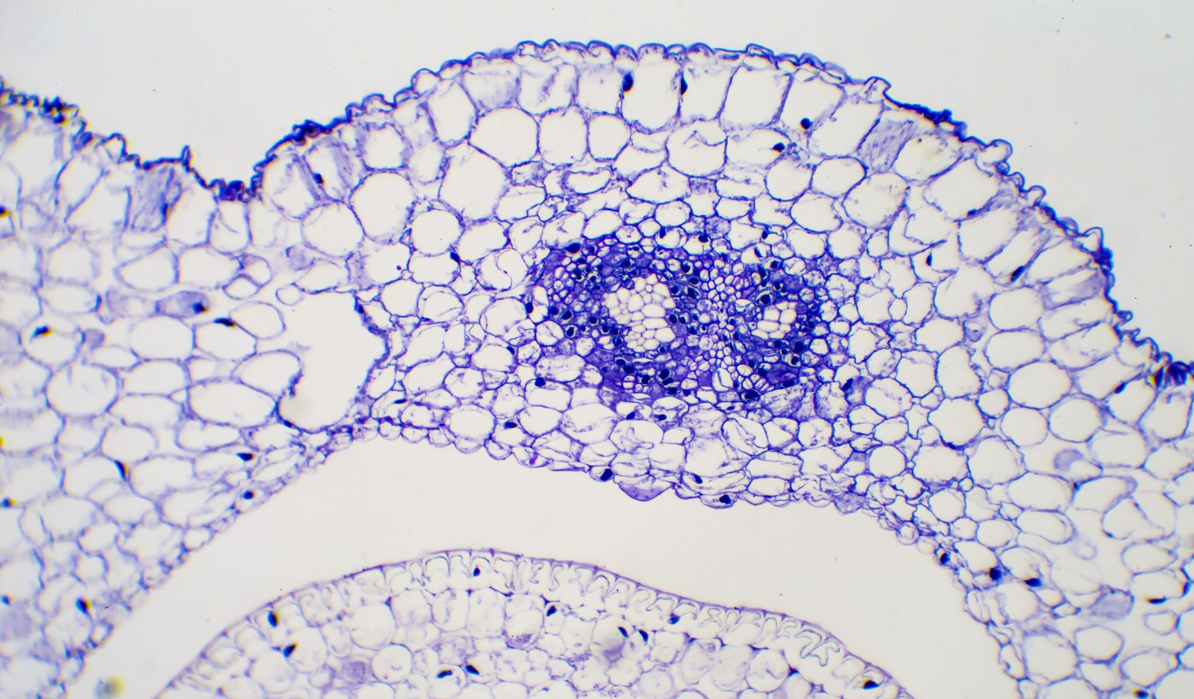
Functional Annotations
Antibiotic resistance
Operons
Prophage
Virulence
Plasmids
Outer membrane protein
Transmembrane protein
Signal peptide
Crispr
ncRNA

Slide 5
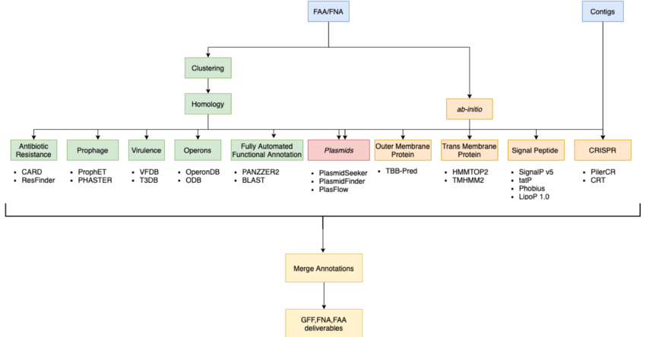
In: .faa/.fna files
Clustering
Antibiotic Resistance
Prophage
Virulence
Operons
Fully Automated Functional Annotation
Plasmids
Outer Membrane Protein
Trans Membrane Protein
Signal Peptides
CRISPR
ncRNA
Merge Annotations
Out: .gff, .fna, .faa deliverables

Slide 6
Fully Automated Functional Annotation
PANNZER
PANNZER is a fully automated service for functional annotation of prokaryotic and eukaryotic proteins of unknown functions. This tool is designed to predict the functional descript (DE) and GO classes
Runtime takes approximately an hour. According to literature papers, is much faster than running BLAST.
Input: FASTA
Output: CSV
Blast2GO
Blast2GO is a bioinformatics platform for automatic, high-through output functional analysis. Its main purpose is enabling Gene Ontology (GO) based data mining.
Input: FASTA
Output: XML

Slide 7
Clustering
Clustering sequences into groups of similar sequences
Helps identify and summarize key potential functional groups
Representative-based clustering
Cascaded clustering
Database options:
UniRef50, UniRef90, UniRef100
UniProt, UniProt-Swiss
PDB (Protein DataBase)
Many, many others
Notes:
Representative-based clustering – selects one representative sequence based on each cluster, calculates sequence identify like BLAST from the representative
Cascaded clustering – several iterative rounds of increasing sensitivity. Ex. Diamond has –fast, --sensitive, --very-sensitive, --ultra-sensitive

Slide 8
Clustering Tools: Diamond vs. MMSeqs2
Diamond
The clustering criterion is defined by sequence coverage of the local alignment as well its sequence identity
Supports multithreading
Has sensitive and recluster options
Input: FASTA
Output: .tsv
Installation available through bioconda
MMseqs2
Has easy-linclust option for clustering large datasets
Designed to run on multiple cores/servers
Can download various reference databases
Input: FASTA/FASTQ, but converted to database for processing
Output: .tsv
Installation through bioconda
Notes:
Mmseq2: no direct multithreading parameter
Output tsv file: two colomns, representative accession as the first column and the member sequence accession as the second column.

Slide 9
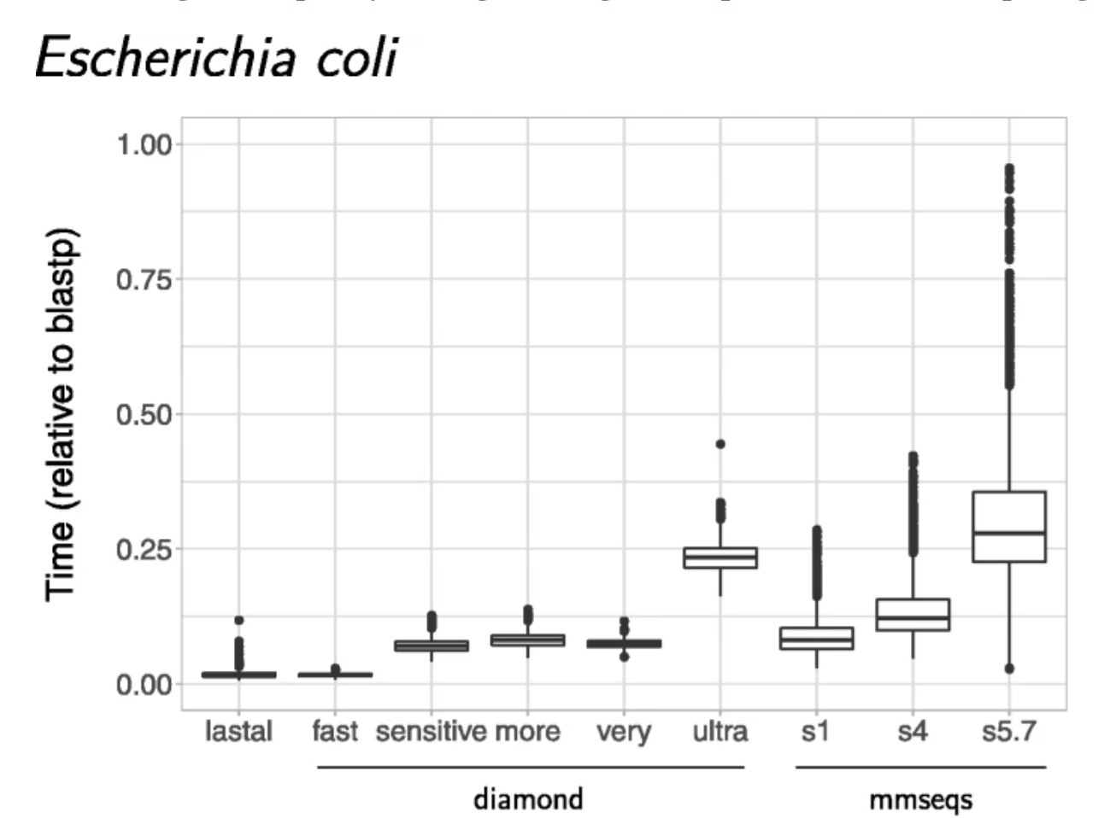
Clustering tool comparison paper: Fig. 1
Comparison using NCBI’s refSeq database
Similar error rates measured across tools
“…diamond, ran with the very-sensitive option, might be the best alternative to obtain RBH in terms of speed, sensitivity and quality.”
Difference in speed obtaining pairwise alignments. The times plotted are the “real” times, as measured by the time UNIX command, relative to blastp. The fastest of the three programs we tested was lastal. Both diamond and mmseqs were tested with different sensitivity options
Hernández-Salmerón, J.E., Moreno-Hagelsieb, G. Progress in quickly finding orthologs as reciprocal best hits: comparing blast, last, diamond and MMseqs2. BMC Genomics 21, 741 (2020). https://doi.org/10.1186/s12864-020-07132-6
Notes:
RBH (reciprocal best hits)
Mmseqs is MMseqs2

Slide 10
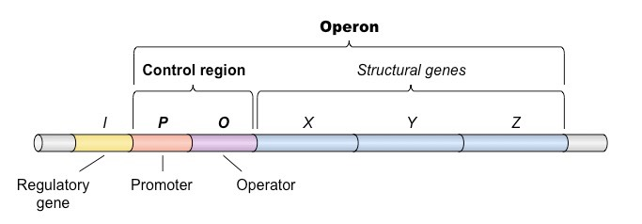
Operons
What is an operon?
Unit of genetic material comprises functionally related genes transcribed together as a single unit from a single promoter site.
Method of gene regulation in prokaryotes and some eukaryotes.
Annotating operons involves analyzing gene prediction results and comparing the sequences to known operon sequences in databases, thus determining the genes involved in crucial cellular processes and metabolic pathways.

Slide 11
Operons
Command line tool for operon prediction:
POEM
POEM (Prediction Of Operons from Metagenomes) is a pipeline that predictions of operons from metagenomic data, including genome assemblies and short reads.
Input file: “ .fsa", a FASTA file containing metagenomic reads.
Uses CD-HIT for clustering and performs a BLASTp search against the COG database.
Relevant output file: “ .operon” that provides the full list of predicted operons.
Drawbacks: Github has not been recently updated.
MetaRon
MetaRon uses MetageneMark or Prodigal outputs for functional annotation.
Prerequisites for operon prediction only: antiSMASH, BOWTIE2 (conda install available)
Required input files: gene prediction files and scaffold
Output file: operon predictions “Operon_File.tab”
Drawbacks: requires several dependencies

Slide 12
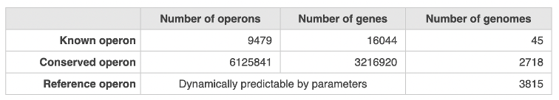
Operons
Operon Databases:
ODB
ODB (Operon DataBase) is a database that provides candidate operons based on the orthologous genes that are conserved in the genomes. The database merges predicted well-conserved operons and known literature-based operons.
Statistics:
MicrobesOnline
MicrobesOnline makes predictions based on how apart adjacent genes in an operon (if not in the same operon), conservation and if they code for genes with similar functions.
General workflow to obtain annotated genes from databases:
Download annotation tables for the gene sequence.
Obtain reference sequences using Gene ID
Build a reference database using BLAST
Convert output file to the output file format ( eg- .gff)
Database of choice

Slide 13
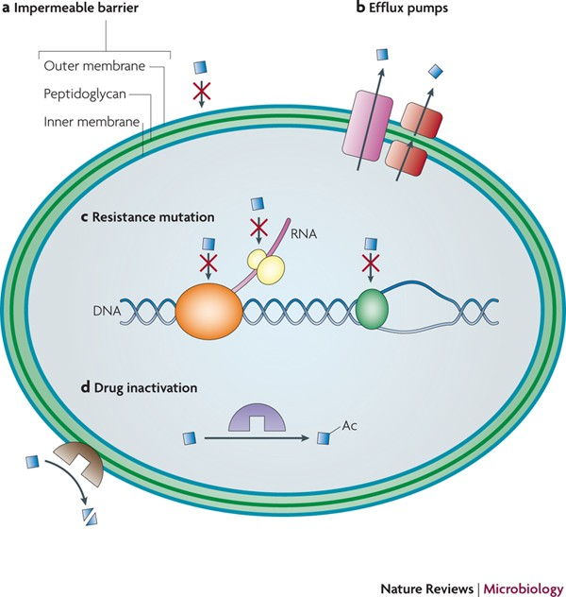
Antibiotic resistance genes
What are Antibiotic resistance genes?
Antibiotic resistance genes encode proteins that confer resistance to antibiotics.
Relevance of annotating antibiotic resistance genes?
The presence of these genes in prokaryotes poses a public health threat, as it can lead to the development of antibiotic-resistant infections in humans and animals.
Hence controlling and monitoring the spread of antibiotic resistance genes in prokaryotic organisms is critical.

Slide 14
Antibiotic resistance genes
Command line tools for antibiotic resistance gene prediction:
AMRFinderPlus
AMRFinderPlus uses a comprehensive and up-to-date database of known antimicrobial resistance genes and mutations to identify potential resistance genes in bacterial genomes accurately.
Available through bioconda.
Size of conda package is approximately 2 GB
Input files: “ .fa” and “ .gff”
Output file: “ .tsv”
DeepARG
DeepARG predicts antimicrobial resistance genes in bacterial genomes or metagenomes using deep learning.
Dependencies:
diamond version 0.9.24
Python version 2.7.14 - 2.7.18
Available through bioconda
Size of conda package is approximately 6.3 GB including the databases
Input files: “ .fa”
Output files:
.ARG (contains the sequences with a probability >= --prob (0.8 default)
.potential.ARG (sequences containing a probability < --prob (0.8 default)).
ResFinder
ResFinder annotates acquired antimicrobial resistance genes in total or partially sequenced bacterial isolates.
Installation is through pip.
Size excluding dependencies is 130 MB (including databases).
Dependencies:
BLAST
KMA
Input files: “ .fa”
Output file: “ .txt”

Slide 15
Antibiotic resistance genes
Antibiotic resistance gene databases:
CARD
Comprehensive Antibiotic Resistance Database (CARD) is a web-based database containing information and data on antibiotic resistance genes and associated antibiotics.
Statistics: 26,000 resistance gene sequences, > 2,500 antibiotics, and > 800 resistance mutations.
Compressed size is approximately = 111 MB
Has a command-line tool: RGI

Slide 16
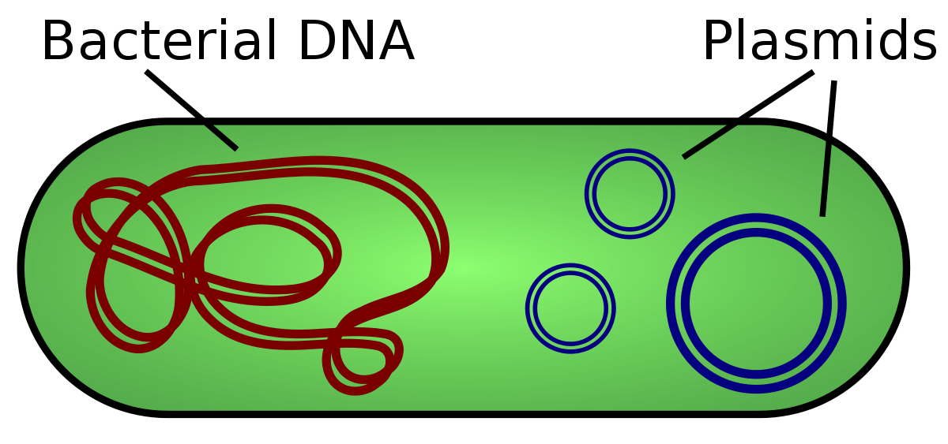
Plasmids
In addition to one large circular chromosome in bacteria, smaller plasmids also exist in the cell
Plasmids are circular DNA molecules smaller and separate from the main chromosomal DNA
Genes found in plasmids often benefit the bacteria
Plasmids can be horizontally transferred to other bacteria

Slide 17
Plasmid Annotation Tools
PlasmidSeeker
K-mer based program for the identification of plasmids from bacterial WGS reads
Designed for sequencing data without read assembly
Also gives you coverage
Input: FASTQ reads, plasmid reference genome
Output: text file
PlasmidFinder
Uses BLAST to look for homologies
Can be used on both raw and assembled data
Command line and webserver
Input: FASTA or FASTQ, PlasmidFinder Database
Output: graphical, text, or tsv
Notes:
https://peerj.com/articles/4588/
https://github.com/bioinfo-ut/PlasmidSeeker
https://link.springer.com/protocol/10.1007/978-1-4939-9877-7_20

Slide 18
Plasmid Databases
PlasmidFinder Database
559 fully sequenced plasmids associated with the family Enterobacteriaceae in the NCBI nucleotide database
116 replicon sequences that are 80% matches with the replicon sequences identified in the sequenced plasmids
PLSDB
13,789 plasmid records collected from the NCBI nucleotide database
Designed to be used with BLASTn
Notes:
https://pubmed.ncbi.nlm.nih.gov/30380090/
https://ccb-microbe.cs.uni-saarland.de/plsdb/
https://academic.oup.com/nar/article/47/D1/D195/5149885?login=true

Slide 19
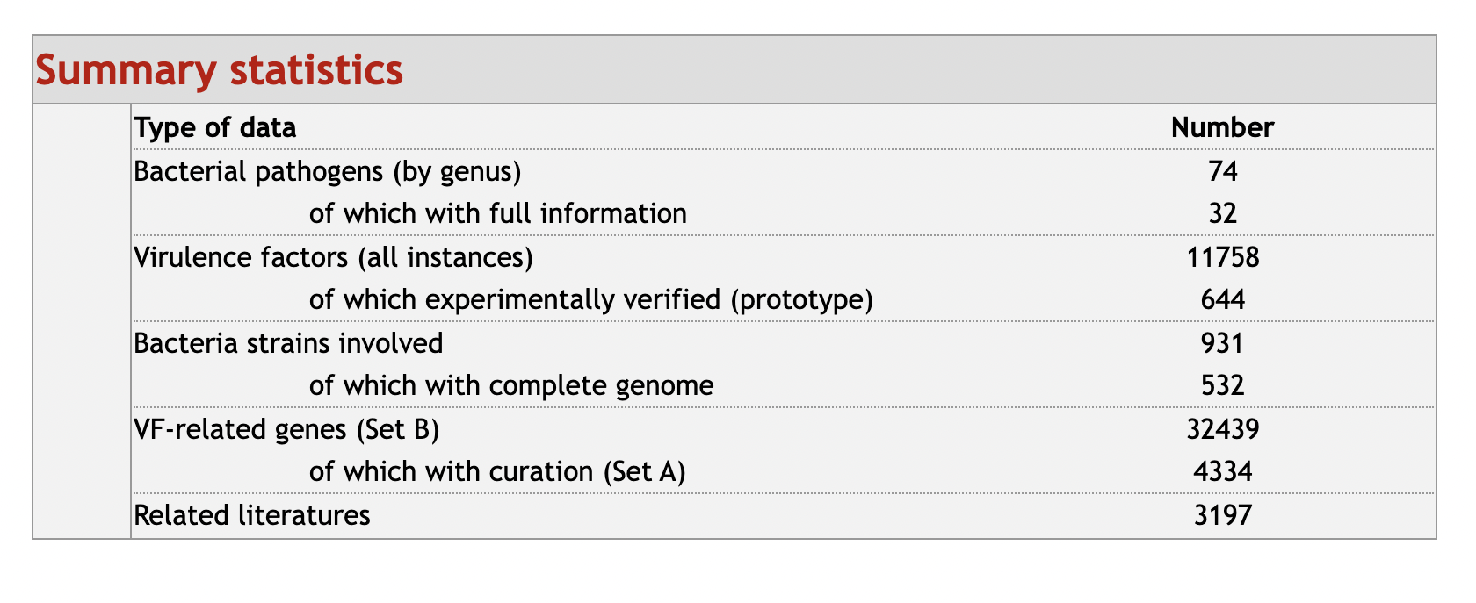
Virulence Factor/Prophage
Virulence factors
cellular molecules or structures that assist bacterium colonize the host.
Data base:
VFDB: integrated and comprehensive online resource for curating information about virulence factors of bacterial pathogens
Online analysis (VFanalyzer) or downloaded as FastA.
Size: 4.86 mb(protein), 9.01mb (DNA)
Notes:
Ref: https://academic.oup.com/nar/article/50/D1/D912/6446532
https://microbiomejournal.biomedcentral.com/articles/10.1186/s40168-020-00993-9

Slide 20
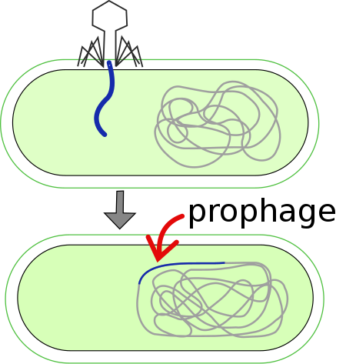
Virulence Factor/Prophage
Prophage: bacteriophage genome that's inserted and integrated into the host genome.
Common database:
PHROGs: Prokaryotic Virus Remote Homologous Groups database
868,340 proteins from complete genomes from phage.
12,498 curated prophages derived from microbial isolates
fasta file, one MSA and HMM profile
pVOGs(Prokaryotic Virus Orthologous Groups)
3000 genomes and 300,000 proteins.
number of conserved orthologous groups 9518
MSA, HMM profile available

Slide 21
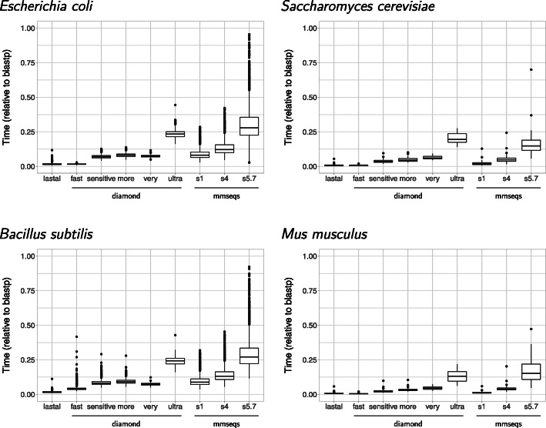
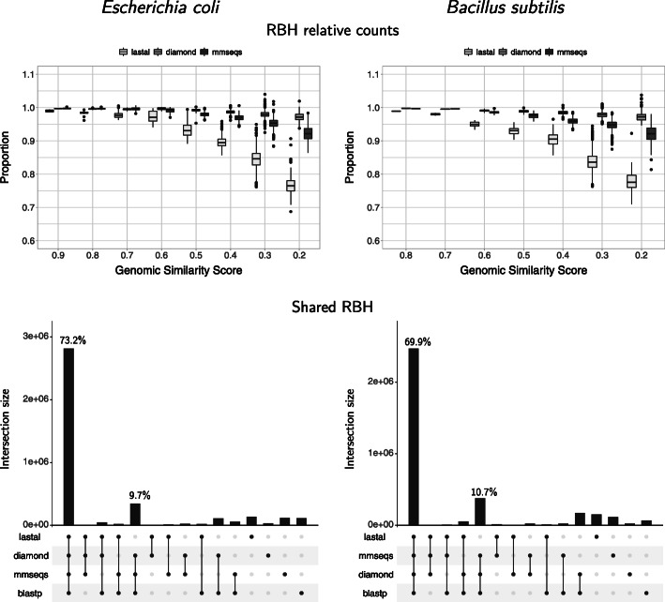
Virulence Factor/Prophage
Common tools for sequence comparison
BLASTp
mmseqs2 (Many-against-Many sequence searching)
DIAMOND BLASTp
lastal
Fig. 1 Difference in speed obtaining pairwise alignments.
Fig. 2 Reciprocal best hits found by all programs with bacterial proteomes
Notes:
RBH: reciprocal best hit

Slide 22
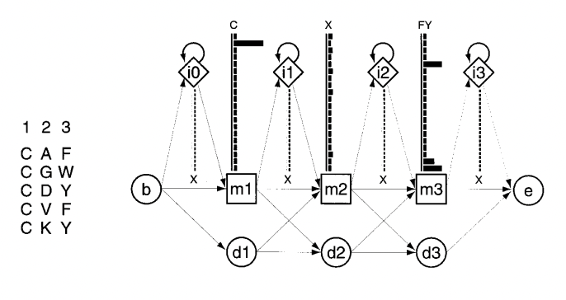
Virulence Factor/Prophage
HMMscan/ HMMsearch
Query sequence against the HMM profile
HMM profile: probabilistic models that encapsulate the evolutionary changes that have occurred in a set of related sequences.
Each match state: Insertion state (has emission probability), deletion state (mute), emission state (20-residule probability)
Notes:
Three columns: three match states (m1 m2 m3), three deletion states (mute, no emission state), 20 emission probabilities

Slide 23
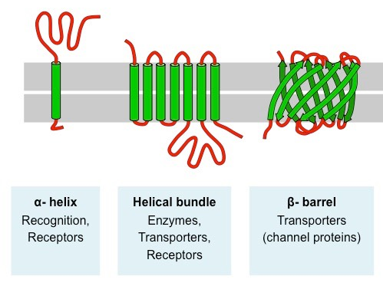
Transmembrane Proteins
Proteins which span across the outer cellular membrane
Often have key functions which are important to the cell
Cell signalling, adhesion, transport, etc.
Has a typical amino acid residues which allows interaction with the lipid bilayer
α-helix, β-barrels
Notes:
https://ib.bioninja.com.au/standard-level/topic-1-cell-biology/13-membrane-structure/membrane-proteins.html

Slide 24
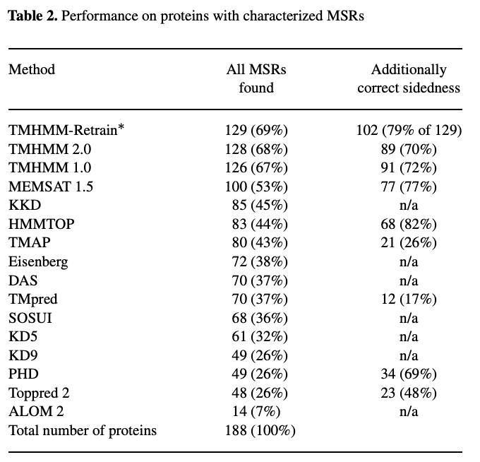
Transmembrane Tools
TMHMM (2001)
Uses hidden Markov model
Similar to HMMTOP but TMHMM2.0 outperforms it
Webserver or download available online
DeepTMHMM (2022)
Predicts transmembrane regions using a deep learning model
Can be run using Python
Not homology-based so no large databases involved
Homology-based:
RSCB Protein Data Bank (4,135 structures) ~2GB?
UniProtKB 13,072,232 results
S. Möller, et al. (2001)
Notes:
Hallgren et al., “DeepTMHMM Predicts Alpha and Beta Transmembrane Proteins Using Deep Neural Networks.”
”TMHMM error” 180,000 google search results
Databases: searching “transmembrane” and “bacteria”
UniProtKB search: taxonomy_name:bacteria (cc_scl_term:SL-9904) OR (cc_scl_term:SL-9905) OR (cc_scl_term:SL-9908) OR (cc_scl_term:SL-9906) OR (cc_scl_term:SL-9907) OR (cc_scl_term:SL-9909)
“deepTMHMM error” 5380 google search results

Slide 25
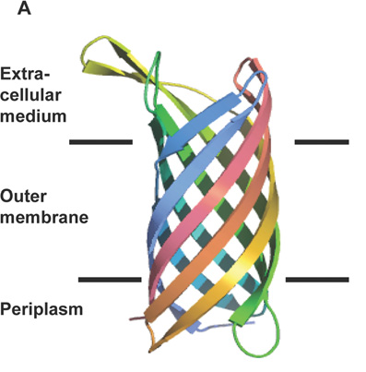
Outer Membrane Proteins
Characterized by antiparallel β-strands in a barrel shape
Predictive tools
Webserver-based:
Hhomp, BOMP, PPA-OMP, Hhpred, PRED-TMBB2
ConBBPRED (Consensus Prediction of Transmembrane Beta-Barrel Proteins)
TOPCONS
Generates topology profile followed by a dynamic programming algorithm (HMM)
Can submit batch script.py to the TOPCON WSDL API
Notes:
Image: https://www.researchgate.net/publication/41406960/figure/fig3/AS:340525321342985@1458198971326/Structures-of-the-b-barrel-outer-membrane-proteins-NspA-and-Opc-A-The-ribbon-diagram.png
Finds highest scoring path to assign it as a signal peptide (S), a membrane region (M) or the membrane-inside and outside (i and o, respectively)
WSDL API – webserver request

Slide 26
Outer Membrane Proteins
Homology-based
PSI-BLAST, BLAST
Databases
Protein Data Bank www.rscb.org
Congregates data from other databases
OMP has outer membrane proteins
OMBdb http://www.ompdb.org/
Notes:
Image: https://www.researchgate.net/publication/41406960/figure/fig3/AS:340525321342985@1458198971326/Structures-of-the-b-barrel-outer-membrane-proteins-NspA-and-Opc-A-The-ribbon-diagram.png

Slide 27
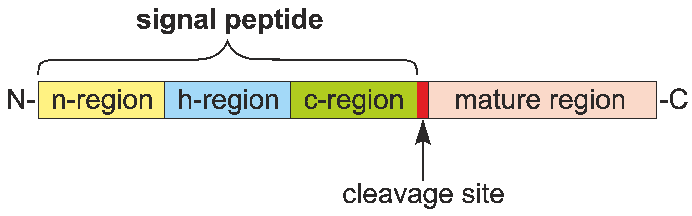
Signal Peptide
Signal Peptide are located at the N-terminal of proteins
A peptide segment contains about 16-40 amino acids
Carry info for protein secretion
Prompts and facilitates protein translocation and plays a role in protein targeting

Slide 28
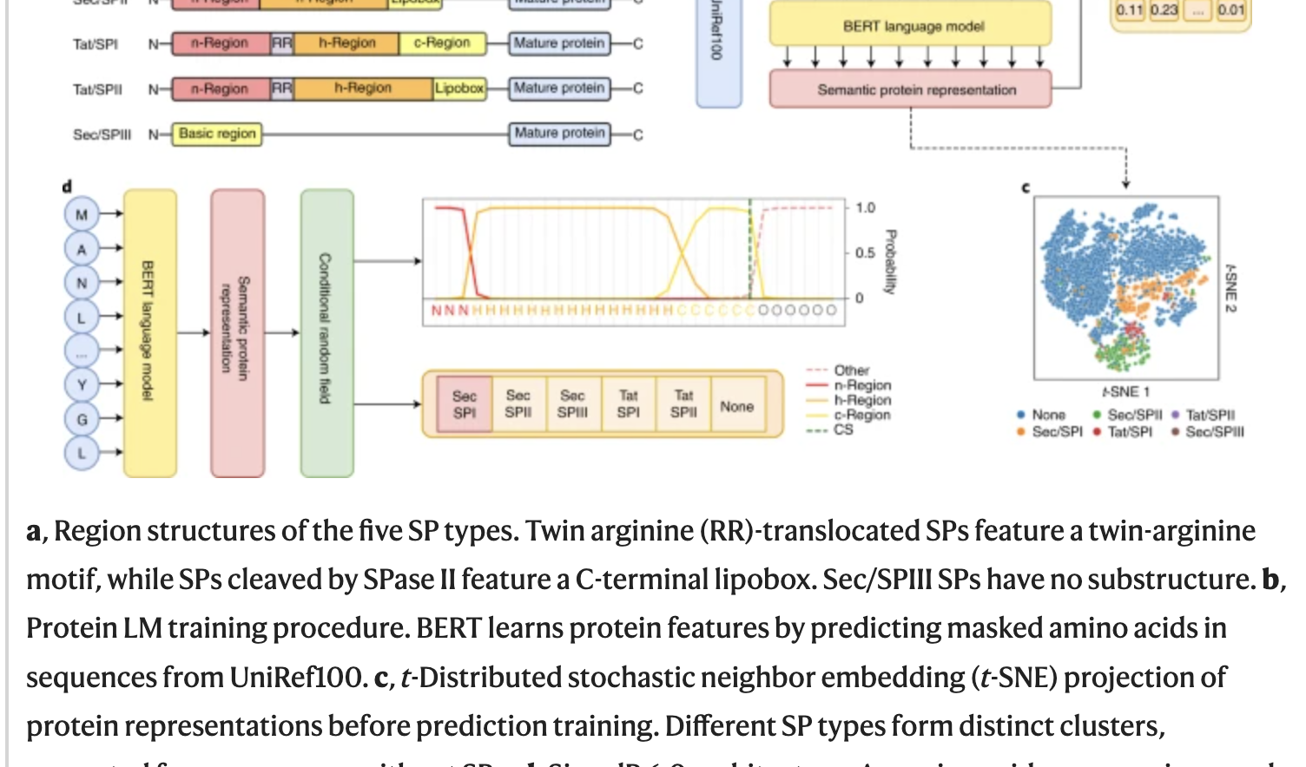
SignalP
Based on Protein Language Model (LMs)
Predict the presence and location of signal peptide cleavage sites in amino acid sequences in organisms
Uses two types of neural network-based methods, SignalP-TM and SignalP-noTM
Input file format: fasta file (amino acid)
Output file format: gff3, one-liner fasta
Notes:
https://www.nature.com/articles/s41587-021-01156-3
https://github.com/fteufel/signalp-6.0/blob/main/installation_instructions.md

Slide 29
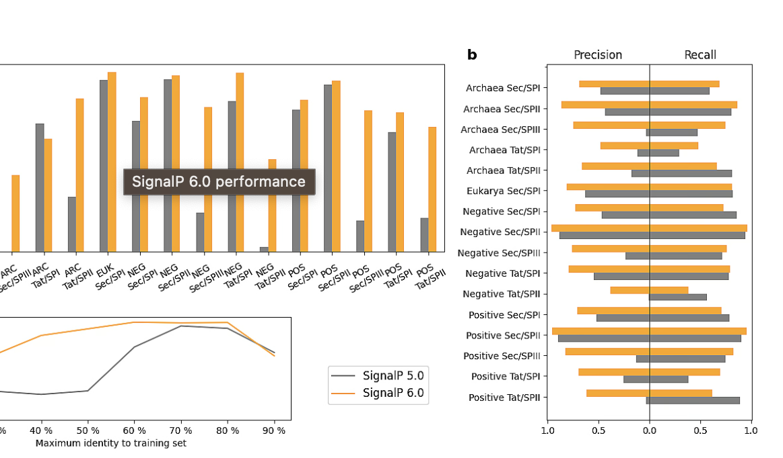
SignalP (5.0 & 6.0)
Pros:
Signal 6.0 version is able to learn rare SP types
6.0v performs much better than 5.0v
6.0v can be used for sequences where the origin is not known
6.0v shows strong performance on all types and organism groups
Notes:
https://bioengineeringcommunity.nature.com/posts/signalp-6-0-predicts-all-five-types-of-signal-peptides-using-protein-language-models

Slide 30
CRISPR
Bacterial “immune system”
Comprised of the cas complex and an array which consists of a series of guide RNAs separated by spacer repeats
Tools include ARAGORN, CRT and Infernal

Slide 31
Proposed Approach and Analysis Workflow
Initial steps:
Testing each tool with a test dataset to determine which tools we will integrate into our pipeline
Coordinating with other teams to determine which datasets to download to the server
Main workflow:
.faa files? from gene prediction group
functional annotation with chosen tools
merge results in a .gff file
clustering

Slide 32
Task Delegation
Operons​ | Akshita
Antibiotic resistance​
Prophage​ | Kate Xie
Virulence​
Fully automated functional annotation​ | Michael
Plasmids ​ | Isabelle
Outer membrane protein​ | Lindsey
Trans membrane protein​
Clustering
Signal peptide​ | Kaize
crispr | Kaize
ncRNA
Each group member will be responsible for testing the tools they researched

Slide 33
References
Hernández-Salmerón, J.E., Moreno-Hagelsieb, G. Progress in quickly finding orthologs as reciprocal best hits: comparing blast, last, diamond and MMseqs2. BMC Genomics 21, 741 (2020). https://doi.org/10.1186/s12864-020-07132-6
Buchfink, B., Ashkenazy, H., Reuter, K., Kennedy, J. A., & Drost, H.-G. (2023). Sensitive clustering of protein sequences at tree-of-life scale using DIAMOND DeepClust (p. 2023.01.24.525373). bioRxiv. https://doi.org/10.1101/2023.01.24.525373
Hallgren, J., Tsirigos, K. D., Pedersen, M. D., Almagro Armenteros, J. J., Marcatili, P., Nielsen, H., Krogh, A., & Winther, O. (2022). DeepTMHMM predicts alpha and beta transmembrane proteins using deep neural networks. BioRxiv, 2022.04.08.487609. https://doi.org/10.1101/2022.04.08.487609
MMseqs2 enables sensitive protein sequence searching for the analysis of massive data sets | Nature Biotechnology. (n.d.). Retrieved March 4, 2023, from https://www.nature.com/articles/nbt.3988
Natarajan, J., & Ganapathy, J. (2007). Functional gene clustering via gene annotation sentences, MeSH and GO keywords from biomedical literature. Bioinformation, 2(5), 185–193.
Steffen Möller, Michael D. R. Croning, Rolf Apweiler, Evaluation of methods for the prediction of membrane spanning regions , Bioinformatics, Volume 17, Issue 7, July 2001, Pages 646–653, https://doi.org/10.1093/bioinformatics/17.7.646
Krogh, Anders, Björn Larsson, Gunnar von Heijne, and Erik L.L Sonnhammer. “Predicting Transmembrane Protein Topology with a Hidden Markov Model: Application to Complete Genomes11Edited by F. Cohen.” Journal of Molecular Biology 305, no. 3 (January 2001): 567–80. https://doi.org/10.1006/jmbi.2000.4315.
https://www.ncbi.nlm.nih.gov/pmc/articles/PMC3013687/
https://academic.oup.com/nar/article/38/suppl_1/D396/3112269#64941422
https://academic.oup.com/nar/article/48/D1/D517/5608993
Sharma, Aditya Kumar et al. “Bacterial Virulence Factors: Secreted for Survival.” Indian journal of microbiology vol. 57,1 (2017): 1-10. doi:10.1007/s12088-016-0625-1
Chen, Lihong et al. “VFDB: a reference database for bacterial virulence factors.” Nucleic acids research vol. 33,Database issue (2005): D325-8. doi:10.1093/nar/gki008
Srividhya, K V et al. “Identification of prophages in bacterial genomes by dinucleotide relative abundance difference.” PloS one vol. 2,11 e1193. 21 Nov. 2007, doi:10.1371/journal.pone.0001193
Hernández-Salmerón, Julie E, and Gabriel Moreno-Hagelsieb. “Progress in quickly finding orthologs as reciprocal best hits: comparing blast, last, diamond and MMseqs2.” BMC genomics vol. 21,1 741. 24 Oct. 2020, doi:10.1186/s12864-020-07132-6
Eddy, S R. “Profile hidden Markov models.” Bioinformatics (Oxford, England) vol. 14,9 (1998): 755-63. doi:10.1093/bioinformatics/14.9.755
CRISPR https://bioinfo.cd-genomics.com/crispr-bioinformatics-analysis.html#:~:text=The%20CRISPR%2DCas9%20gene%20targeting,technique%20with%20many%20possible%20applications.
Noncoding RNA analysis (ncRNAs) https://www.cd-genomics.com/bioinformatics-tools-for-non-coding-rna-analysis.html
Roosaare M, Puustusmaa M, Möls M, Vaher M, Remm M. 2018. PlasmidSeeker: identification of known plasmids from bacterial whole genome sequencing reads. PeerJ 6:e4588 https://doi.org/10.7717/peerj.4588
Carattoli, A., Hasman, H. (2020). PlasmidFinder and In Silico pMLST: Identification and Typing of Plasmid Replicons in Whole-Genome Sequencing (WGS). In: de la Cruz, F. (eds) Horizontal Gene Transfer. Methods in Molecular Biology, vol 2075. Humana, New York, NY. https://doi.org/10.1007/978-1-4939-9877-7_20
Galata V, Fehlmann T, Backes C, Keller A. PLSDB: a resource of complete bacterial plasmids. Nucleic Acids Res. 2019 Jan 8;47(D1):D195-D202. doi: 10.1093/nar/gky1050. PMID: 30380090; PMCID: PMC6323999.

